Slide 1
PROCESSING OF TEA

Slide 2

Plucking (Harvesting) of Tea
Janam plucking:
Imperial
Proved superior in North East India under soil environmental condition
Fine plucking or: mother leaf plucking:
(2 leaves + bud ) Plucking just above the mother leaf (the first normal leaf)
Medium plucking:
or Fish leaf plucking :
3 leaves + bud
Plucking at the point just above the fish leaf.
Coarse plucking:
more than 3 leaves + bud
Black plucking:
A type of plucking, wherein all projections above plucking table, except janam and/or unopened buds are plucked

Slide 3

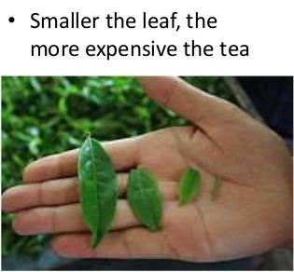

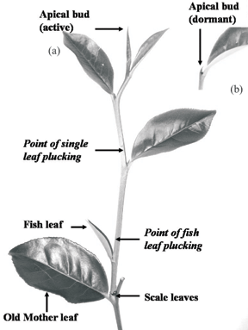
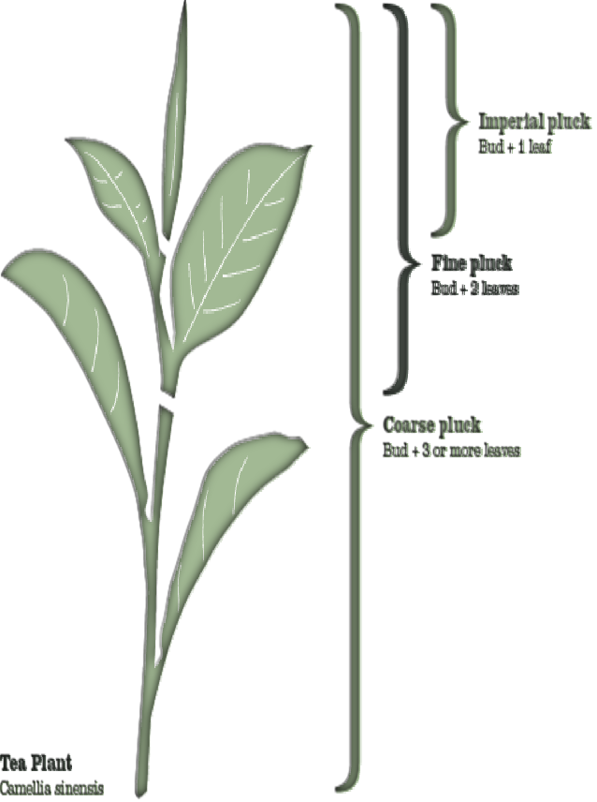

Slide 4
Different standards of tea plucking
S.N | Category of plucking | Type of shoot detached | Plucking round (days) | Net crop gain or loss over standard
1. | Fine | All 1+B, all 2+B & single banjhi | 5-6 | -11.3%
2. | Standard | Large 1+B, all 2+B & single banjhi | 7 | -
3. | Medium | All 2+B, all single & double banjhi | 7-8 | +0.5%
4. | Course | All 2+B, 3+B & all banjhi | 8-9 | +26.2%
5. | Very course | All 3+B, all banjhi | 8-10 | +38.4%
(Single banjhi= one leaf + banjhi bud, Double banjhi= two leaves + banjhi bud)

Slide 5
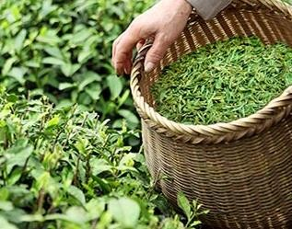
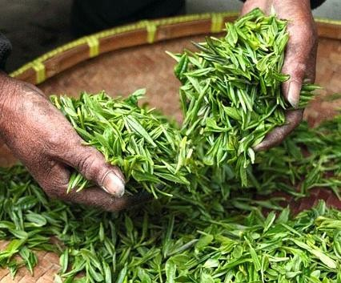
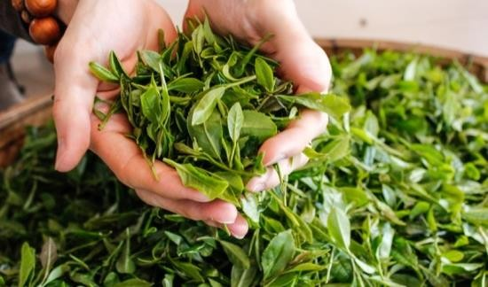
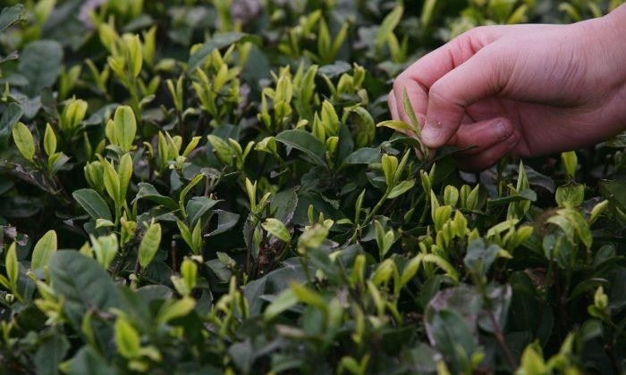
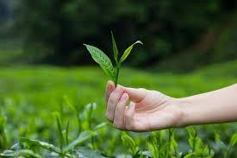
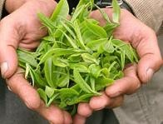
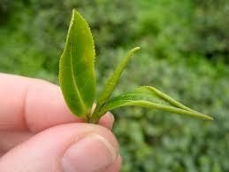
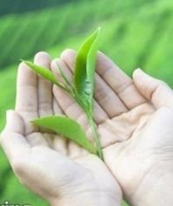
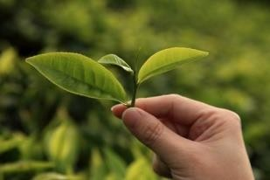
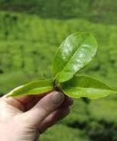
Plucking types (Harvesting) of Tea

Slide 6
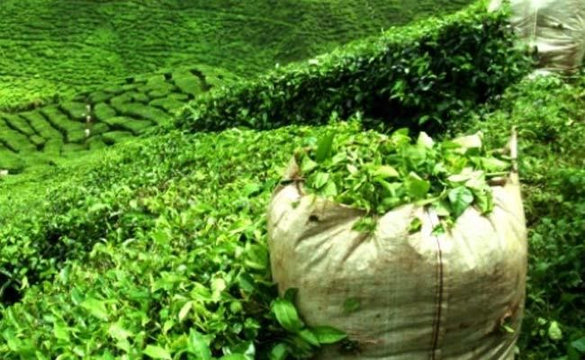
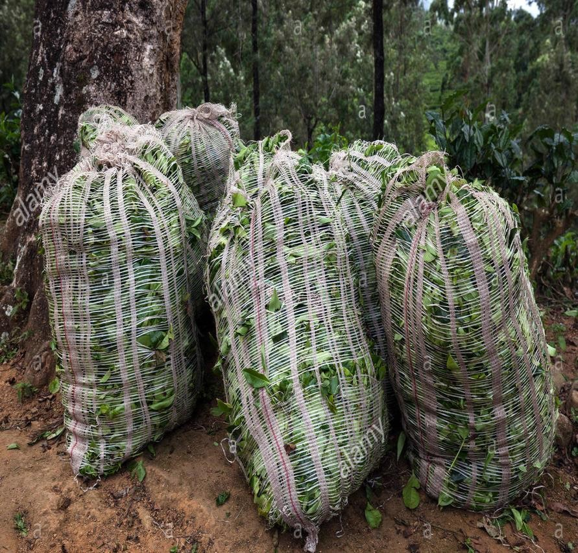
Packing of plucked leaves for processing

Slide 7



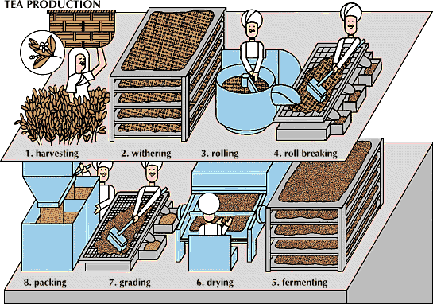
Tea processing

Slide 8
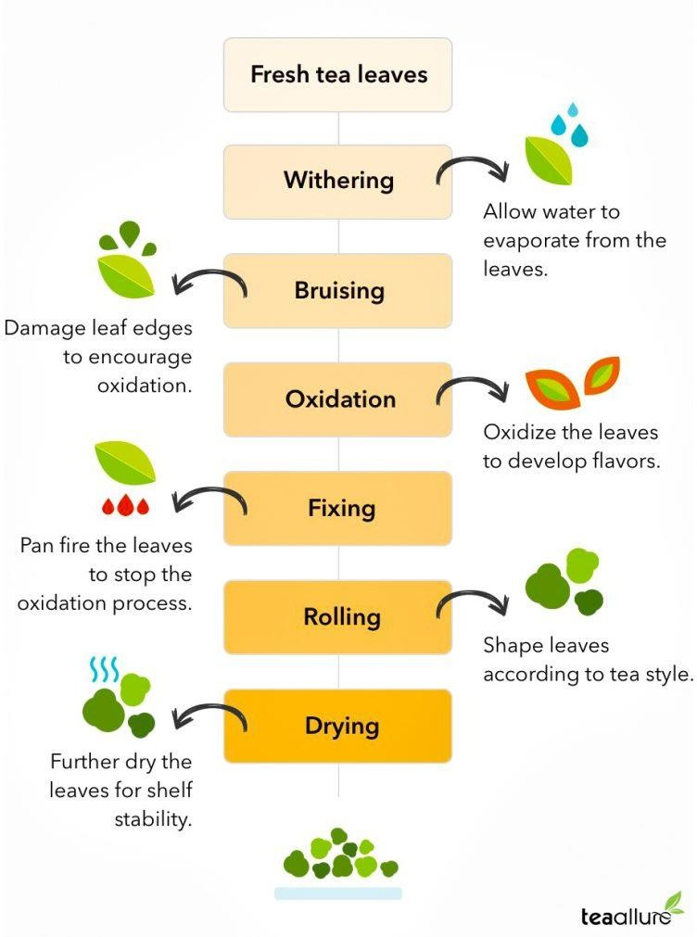
Tea processing

Slide 9

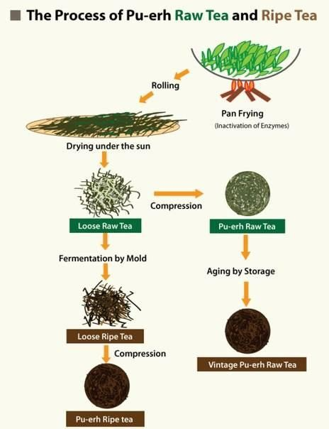

Slide 10



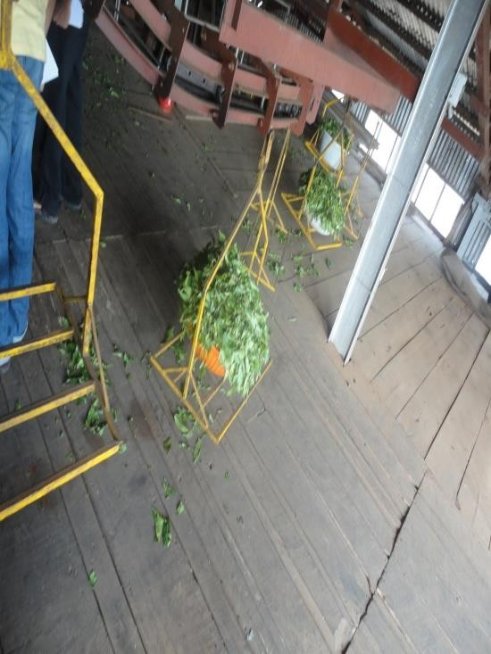
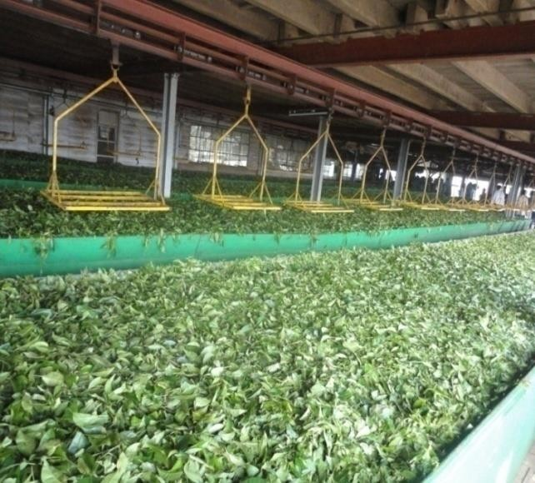
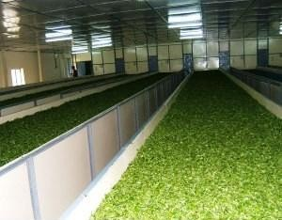
1. Withering:
Removal of surface moisture from leaves
Increases organic acids and PPO activity
CTC | Orthodox
Leaf moisture content 70-75% | 50-55%
Duration 10-15 h | 18-24 h
Tea manufacture involves disruption of the cellular integrity of tea leaves, thereby enabling
the mixing up of substrates (polyphenols) and the enzymes (polyphenol oxidases).
Initiates with the uptake of atmospheric oxygen and formation of oxidized polyphenolic compounds along with volatile flavor compounds that impart characteristic aroma to tea.

Slide 11
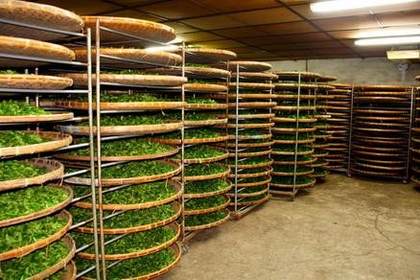
Indoor Withering

Slide 12

Judging the end point of withering
No cracking sound: Well withered leaves will not produce any cracking sound when squeezed i.e., it must not be too dry.
Compact ball: Withered leaves when pressed by hand should form compact ball.
No brittle stalk: The stalk of the withered leaves should not be brittle.
Feel test: Withered leaves will have silk hand feel to touch.

Slide 13
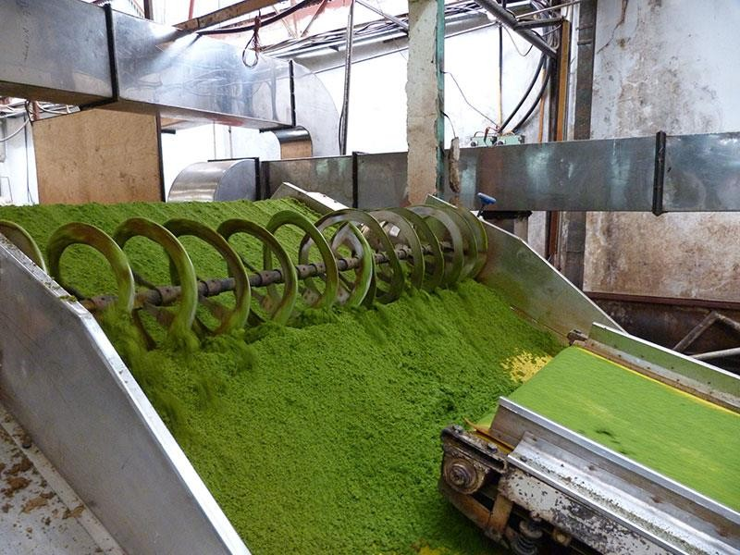
2 .Rolling:
During rolling cells of leaves are broken to liberate sap containing polyphenol oxydase
Rolling takes place for about 30 to 40 minutes.

Slide 14
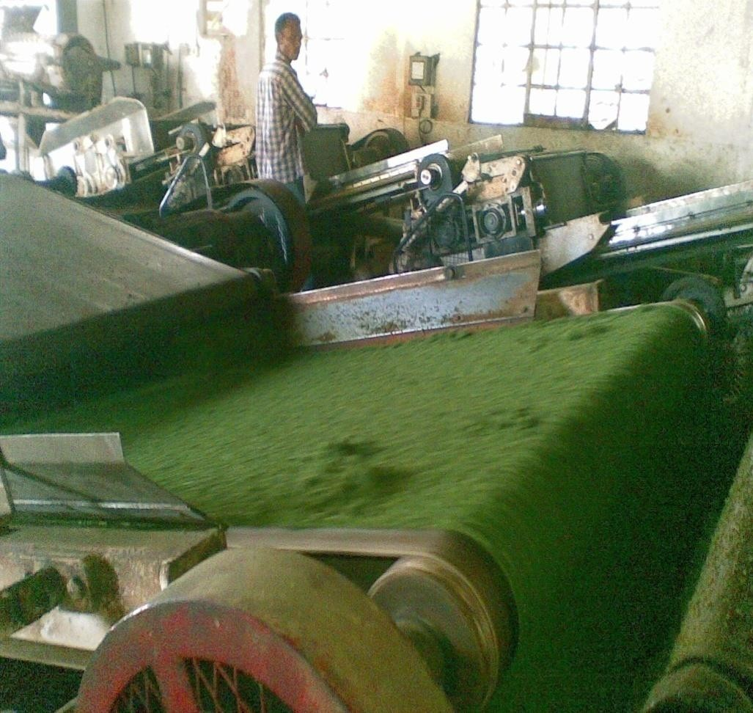
Maceration or Rolling CTC:
Withered leaves rolled through CTC machines
Polyphenol and enzymes exposed to
atmosphere
Well rolled leaf taken for fermentation.
Orthodox method
Rolling of leaves in rollers as if it is rolled
between palms of hands, for 45 min.
Twisting and maceration, well rolled leaf removed (roll breaking)
Well rolled leaf taken for fermentation.

Slide 15
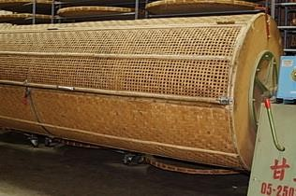

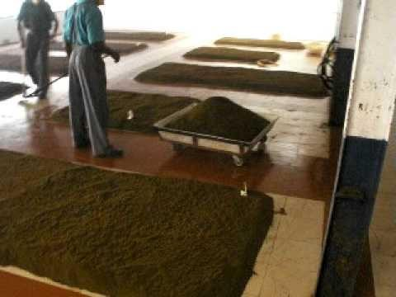








3. Fermentation:
Spreading leaf & Carried out at low temp. (20⁰C) and high 95%RH, 2- 3 h (orthodox method)
In a Revolving drum (25⁰C-27⁰C) for 60-90 min (CTC) with conditioned air
Pleasant aroma & Leaf color green to coppery- completion of
fermentation
Optimum ratio of TF to TR is 1:10-1:12
Catechins
orthoquinones
Polyphenol Oxidase
Theaflavins
Thearubigins
Theaflavins- 0.3-2% of dry wt.-astringency, briskness, color
Thearubiginins- 9-19% of dry wt.-strength, mouth feel color

Slide 16
Duration of fermentation: Generally, in south India, fermentation is done for 60-90 minutes.
Time of fermentation: It varies from one to three hours (1 to 3 hours)
2 hours: Maximum briskness and quality is obtained except strength.
3 hours: Good strength and colour but poor briskness and quality.
During this process the colour of the leaf changes from green to a bright coppery red. Fermentation is carried out under conditions of high humidity and low temperature (24 – 26.6ºC). The end products of fermentation are the aflavins and the arubigins which are responsible for the briskness, brightness and colour of tea liquor.
High temperature fermentation: Too high a temperature results in over – fermentation and inferior product, further changes are arrested by drying in special dryers.

Slide 17


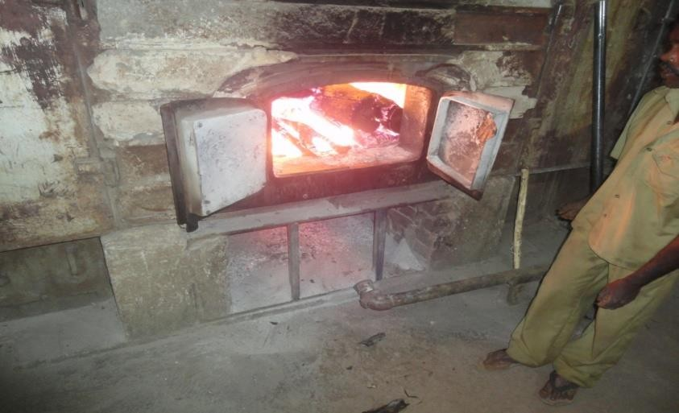
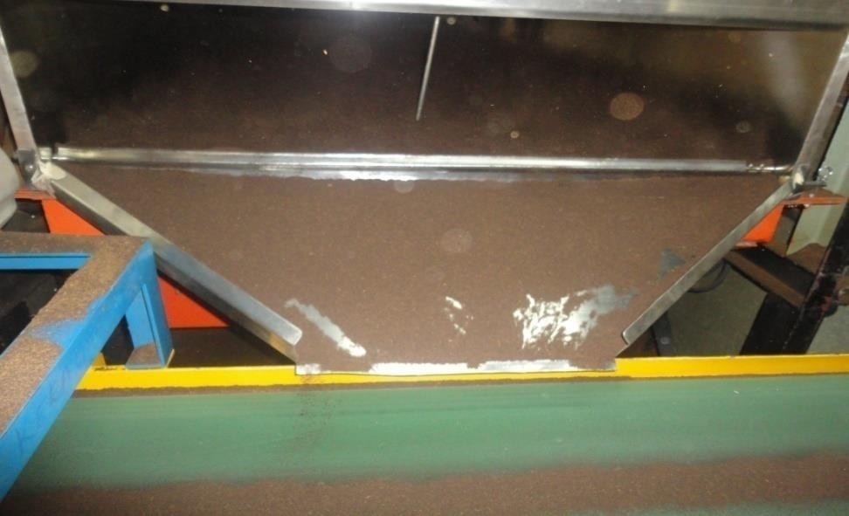
Drying or Firing
Objective of drying is to arrest fermentation.
Slow reduction in moisture content as to stop fermentation process.
Moisture content is reduced to about 4 %.
Duration is for about 30 - 40 minutes.

Slide 18
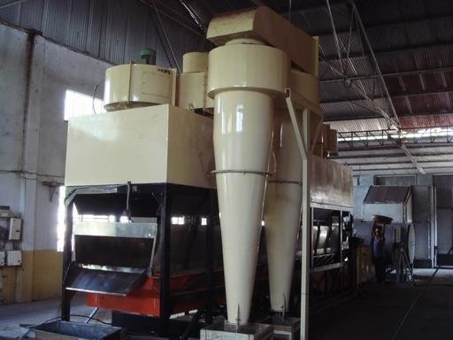



4. Drying
To terminate biochemical reactions
To reduce moisture content (2.5-3.0%)
To improve black tea character and flavour
fermented leaf is subjected to a blast of hot air
The optimal inlet temperature for CTC processed leaf is 100 ± 5°C.
Exhaust temperature 54.4 ± 2.7°C.
Drying below 1.0%- loss in quality.
Above 3.0% moisture content- loss of keeping quality.
Black color due to transformation of chlorophyll to pheophytin
Polyphenols combine with tea leaf proteins- reduction in astringency
CTC tea driers

Slide 19
Sorting and Grading
Remove stalks fibers and grade the tea by passing through different sized meshes.

Slide 20
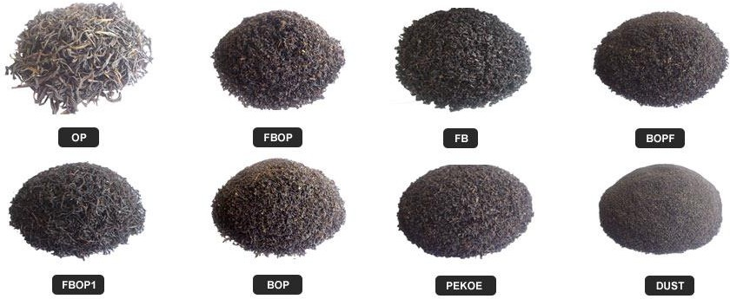
5. Grading
Whole leaf grade | Broken Orange Pekoe, Orange Pekoe, Pekoe, Souchong, BOP fannings, Fannings, Dust
leafy grade | Flowery pekoe, Pekoe
Broken grade | Primary dust (BOP dust, Fine dust) and Secondary dust (Pekoe dust, Golden dust, Superfine dust)

Slide 21
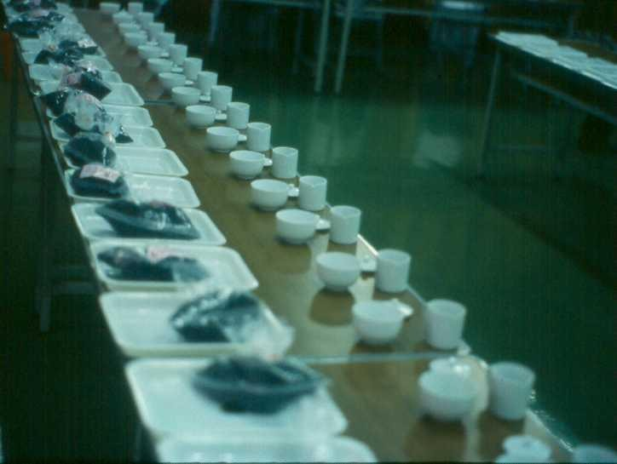
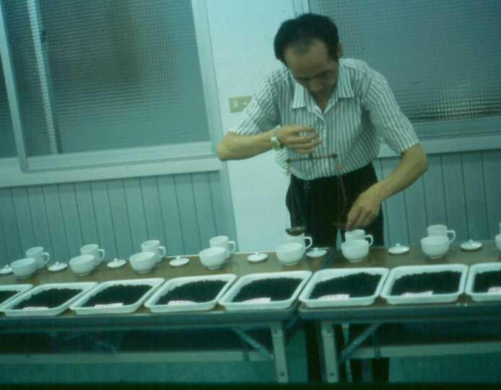
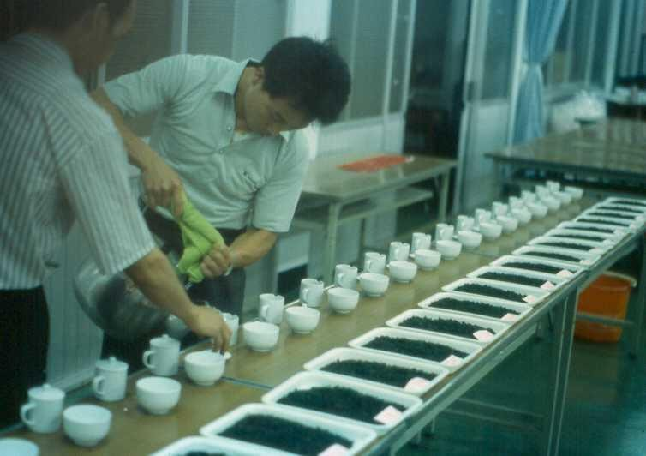
Quality Control
Use same weight of tea per cup
Allowed to steep in hot water same time
Grade indicated by cup placement

Slide 22

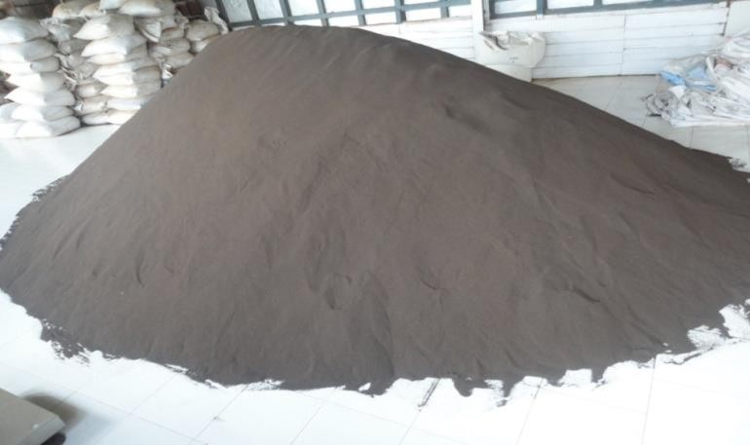
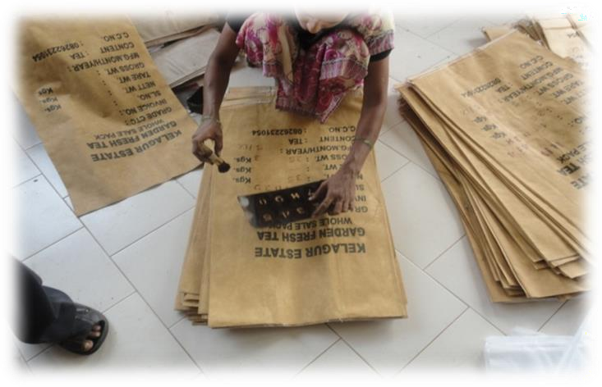
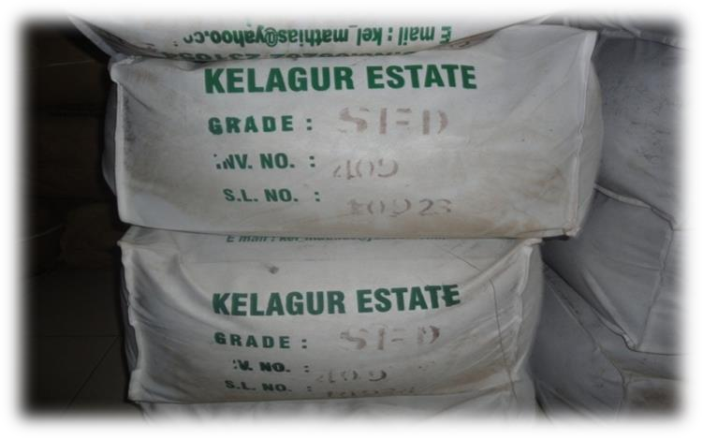
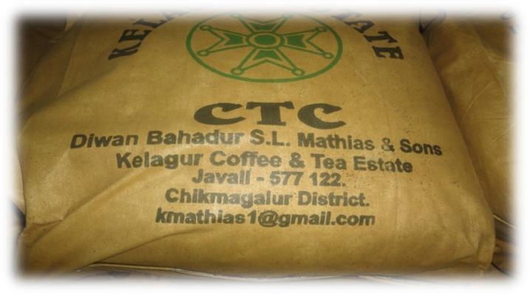


Labeling & packaging

Slide 23
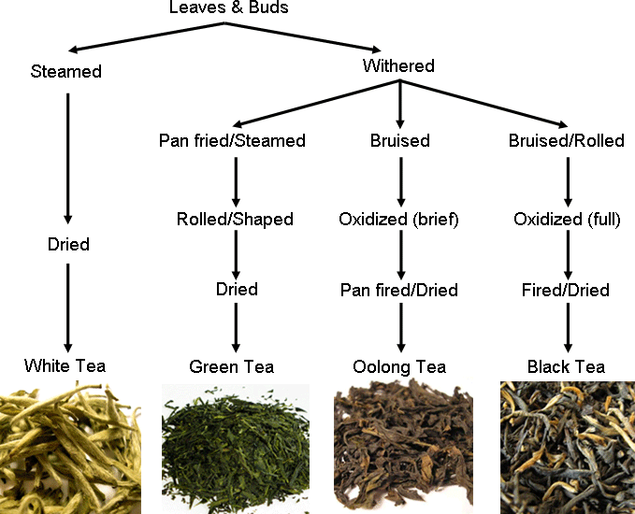

Slide 24
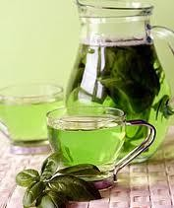
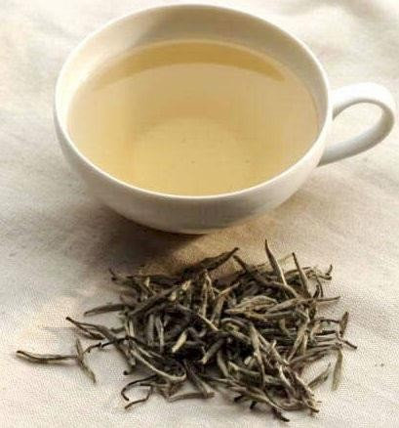
White Tea
Green Tea
Leaf buds fully open and are still covered with fine silky hairs.
Quickly air dried
White tea is said to have three time more antioxidants than green or black tea.
Without fermentation .
China and Japan
Polyphenols, Catechins,
and Flavonoids

Slide 25
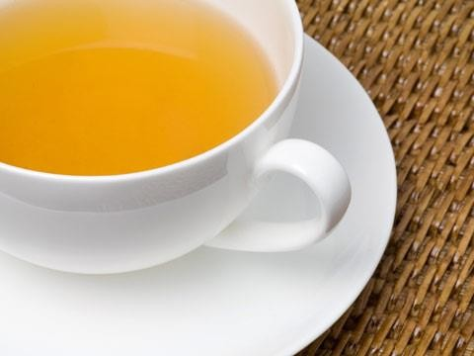
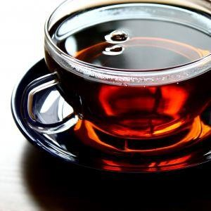
Oolong Tea
Black Tea
between green tea and black tea .
Non fermented tea
“green” and “amber” style.
Global out put 73 %
Fermented
Theaflavin and Thearubigins
•
The “amber” styles are allowed to oxidize slightly more than the “green style” oolong tea.

Slide 26

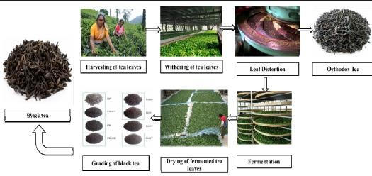
Black tea manufacturing 2 types
1. Orthodox process
withered leaves are rolled on specially designed orthodox rollers which twist and crush the leaves thereby rupturing the cells.
2. CTC (Crush, Tear and Curl)
Withering
Leaf maceration or rolling
Fermentation
Drying
Grading
Maceration is less against CTC processing.
^{T} Tea with good flavor and aroma.
➢
32

